Slide 1
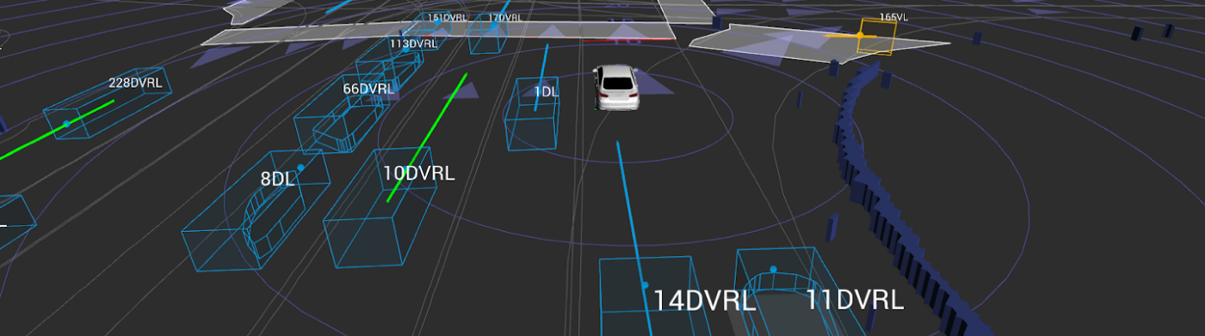
End-to-End Agent Perception and Occupancy-Based Motion Prediction in Bird‘s Eye View
Peizheng Li
20.06.2022

Slide 2
Background
Motion Prediction
+
Occupancy-Based BEV Map
+
End-to-End Approach
||
Our Method
A key component between perception and planning
A new hot spot in motion representation
Lack of well-designed camera-based structures
A novel and promising research topic

Slide 3
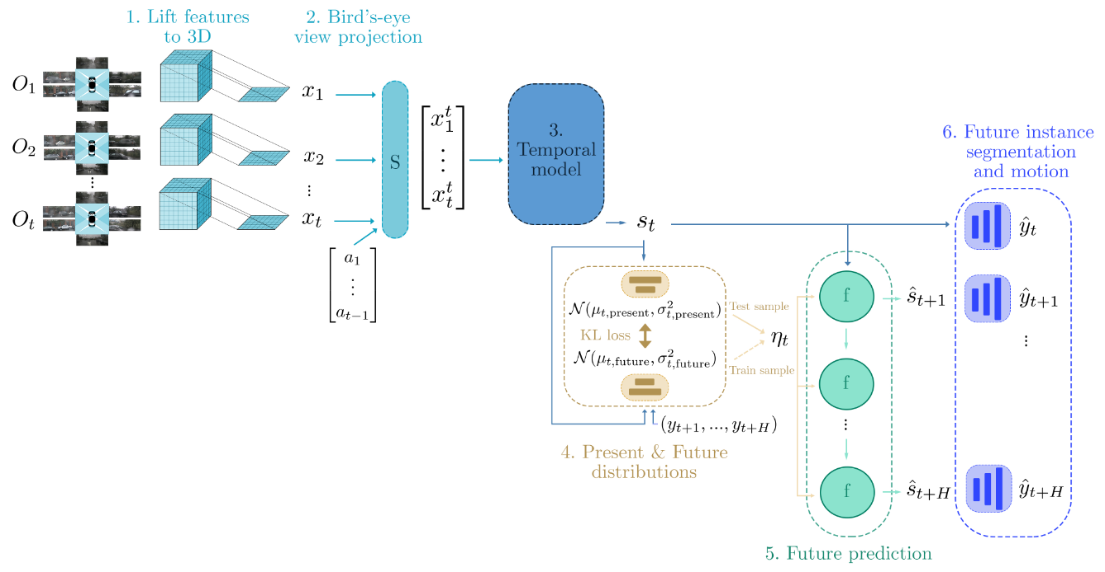
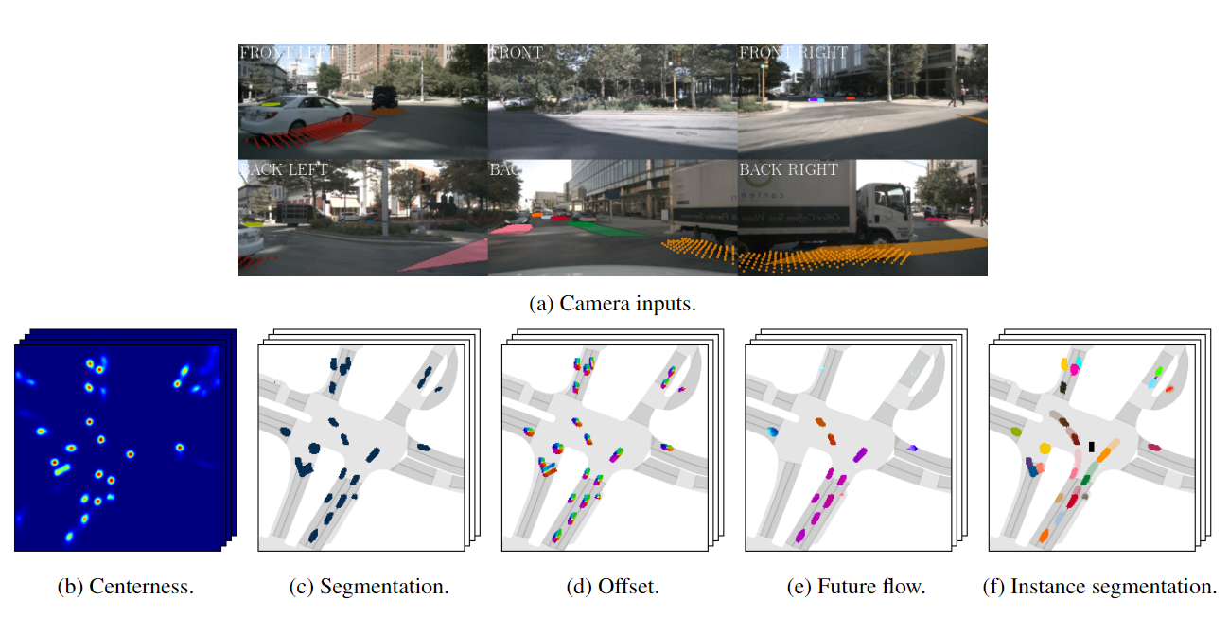
Literature Research FIERY: Future Instance Prediction in Bird’s-Eye View from Surround Monocular Cameras
Pros:
Complete end-to-end structure
Multitasking
Open source code
Cons:
Limited representation capability of features
Autoregressive prediction
Unstable training
https://arxiv.org/abs/2104.10490

Slide 4
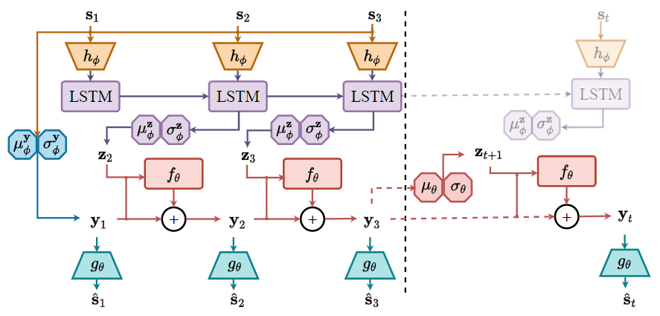
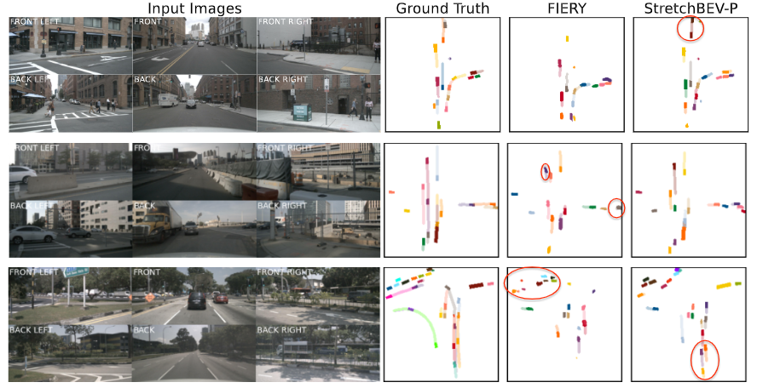
Literature Research StretchBEV: Stretching Future Instance Prediction Spatially and Temporally
Pros:
Learnable time-dependent distributions
Diversity of predictions based on stochastic latent variable
Cons:
Poor feature interpretability
Autoregressive prediction
https://arxiv.org/abs/2203.13641

Slide 5
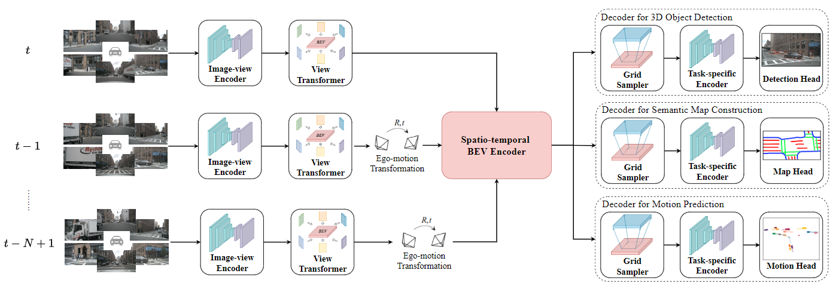
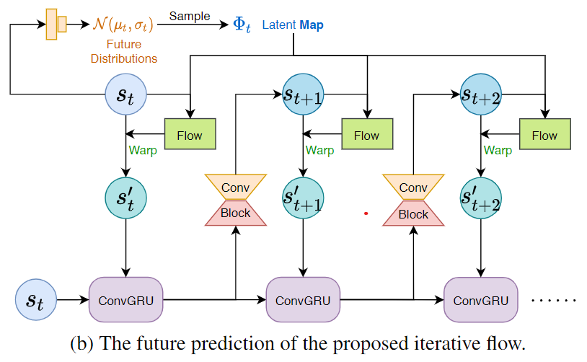
Literature Research BEVerse: Unified Perception and Prediction in Birds-Eye-View for Vision-Centric Autonomous Driving
Pros:
SwinTransformer Backbone
Present reference frame warping
Iterative flow
SOTA
Cons:
Redundant 3D Object Detection Head
Poor feature interpretability
Autoregressive prediction
https://arxiv.org/abs/2205.09743

Slide 6
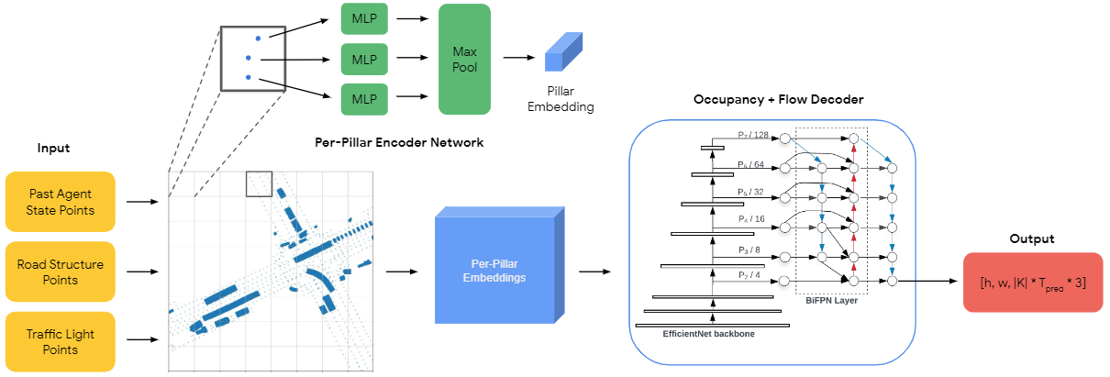
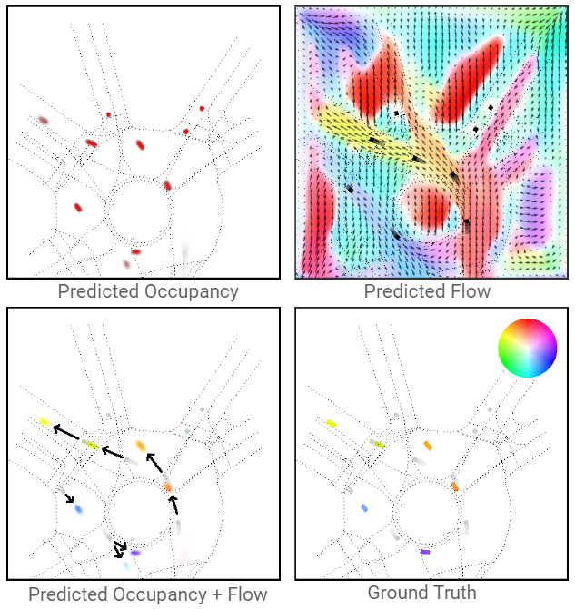
Literature Research Occupancy Flow Fields for Motion Forecasting in Autonomous Driving
Pros:
Novel task definition (occupancy + backward flow)
Multimodal Prediction based on backward flow
Parallel prediction
Cons:
Poor model design
Non-end-to-end approach
https://arxiv.org/abs/2203.03875

Slide 7
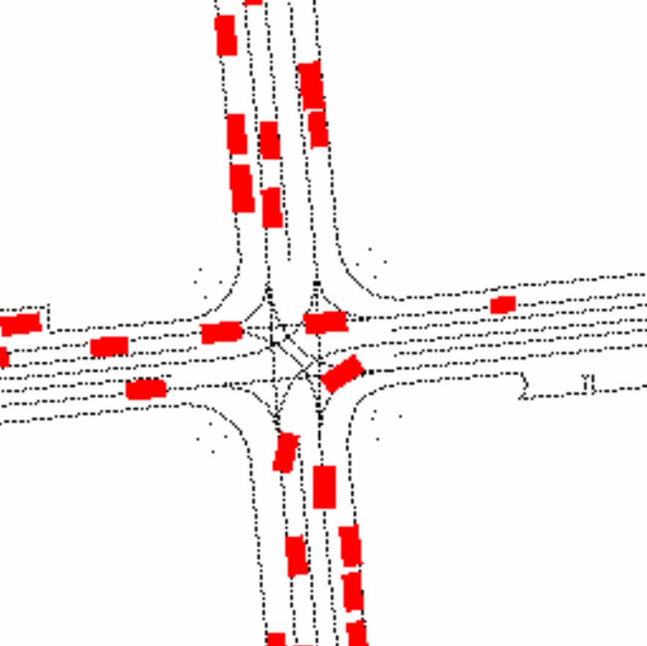
Waymo Challenge: Occupancy and Flow Prediction Our Model
Flow of Scene 1
Spatial-Temporal-Conv2d Module
B × T × C × H × W
B × T’ × C’ × H × W
B × T × C × H × W
B × C’ × T’ × H × W
(B×T) × C × H × W
（B×C’) × T’ × H × W
Encoder
Decoder
Spatial-Conv2d
Temporal-Conv2d
(B×T) × C’ × H × W
（B×C’) × T × H × W
Spatial-Temporal-Conv2d Module
Skip Connection
B × T × C’ × H × W
B × C’ × T × H × W

Slide 8
Waymo Challenge: Occupancy and Flow Prediction Visualization of occupancy and backward flow predictions
Flow of Scene 1
Observed Occupancy of Scene 1
Occluded Occupancy of Scene 1
Flow of Scene 2
Observed Occupancy of Scene 2
Occluded Occupancy of Scene 2

Slide 9
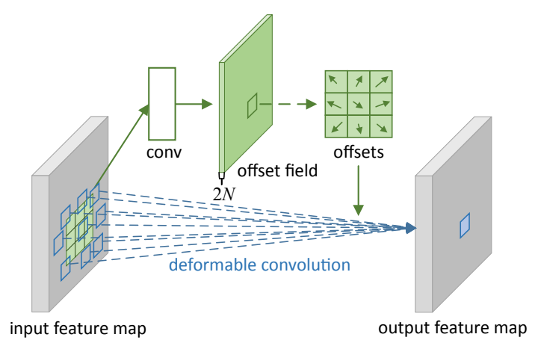
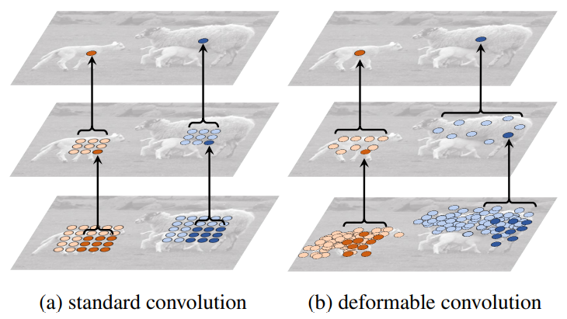
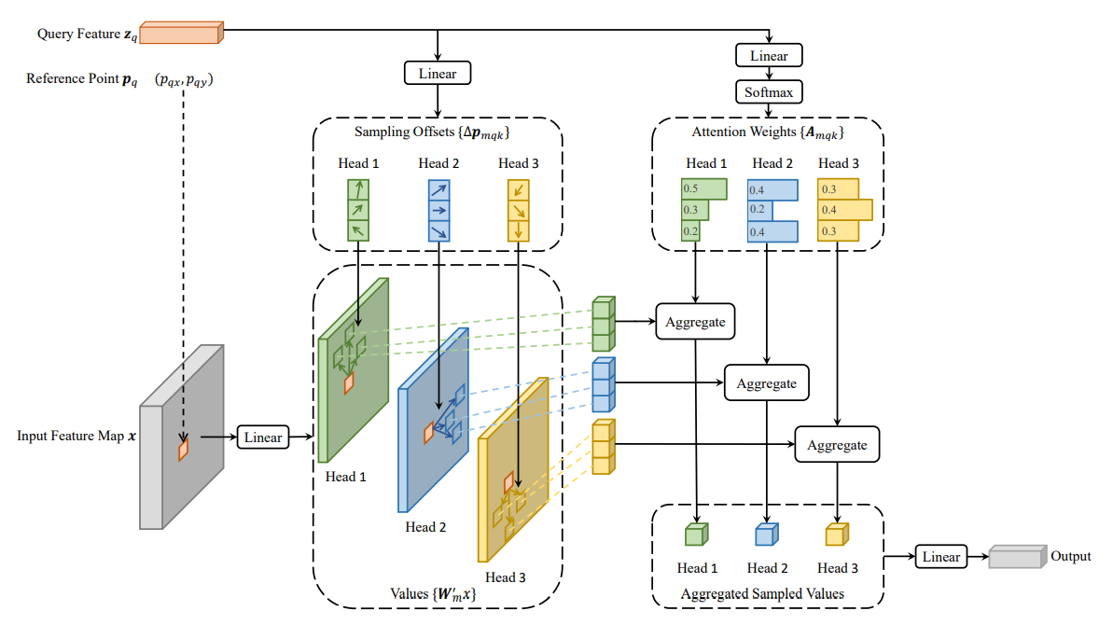
Future Work and Plan
Existing Problems:
No perception module
Redundant computation on blank grids and high memory usage
Ideas and Solutions:
Implementing an end-to-end approach under the Fiery frame
Deformable convolution or deformable Transformer

Slide 10
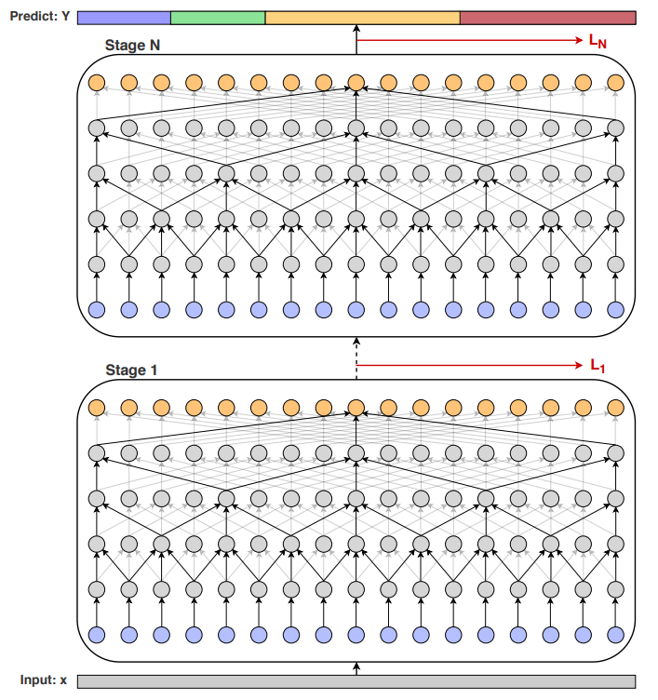
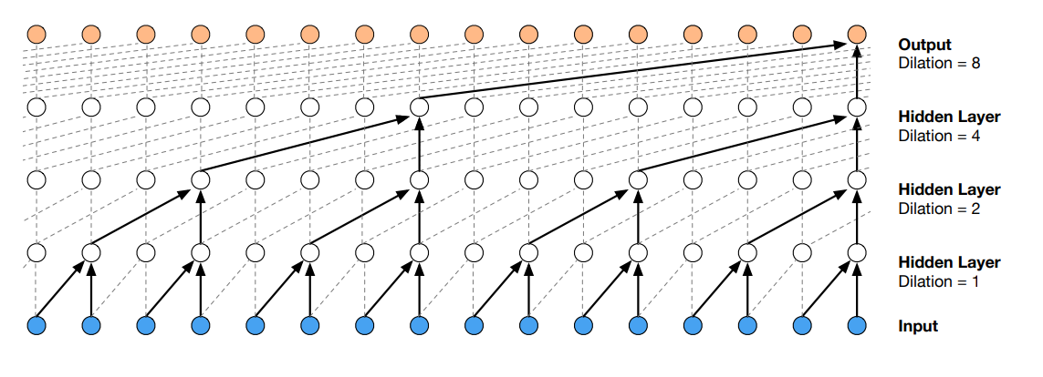
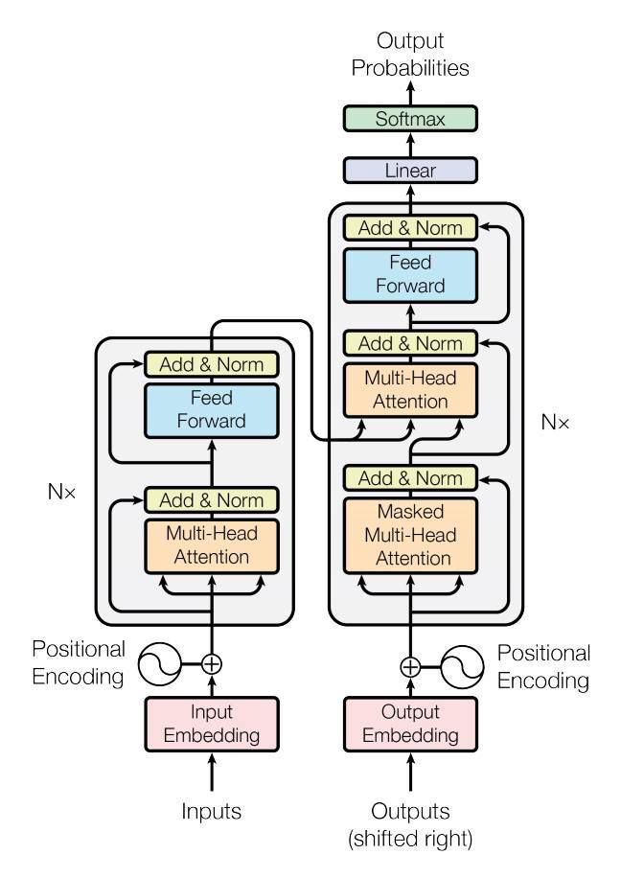
Future Work and Plan
Existing Problems:
Insufficient temporal reasoning
Ideas and Solutions:
Temporal convolutional networks (TCN), causal convolutional networks or Transformer

